Slide 1
Searching for a solution
State Space Search
Uninformed (blind) searching
Informed (heuristic) searching

Slide 2
Introduction
Search is a problem-solving technique that systematically explores a space of problem states,
Examples of problem states might include the different board configurations in a game or intermediate steps in a reasoning process.

Slide 3
Introduction
This space of alternative solutions is then searched to find an answer.
This is the essential basis of human problem solving. Newell and Simon (1976)
Indeed, when a chess player examines the effects of different moves or a doctor considers a number of alternative diagnoses, they are searching among alternatives

Slide 4
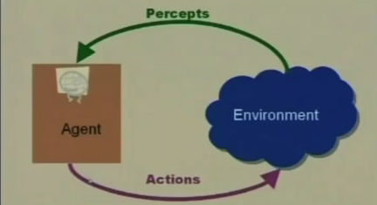

Intelligent Agent

Slide 5
Goal directed Agent
A goal directed agent needs to achieve certain goals.
Many problems can be represented as a set of states and a set of rules of how one state is transformed to another.
The agent must choose a sequence of actions to achieve the desired goal.
Such goal-based agents can be modeled using state space search.

Slide 6
Rational Problem Solving
Problem resolution can be achieved by the following steps:
Problem Formulation
process of deciding what actions and distinct states to consider, given a goal
Representation
abstraction scheme to capture the essential features of a problem for use by a problem solving procedure
State Space Search
a sequence of actions that moves from the initial towards the goal state

Slide 7
Problem Formulation
1. Initial State
The initial state of the problem, defined in a suitable manner
2. Operator(s)
An action or a set of actions that moves the problem from one state to another
3. Neighbourhood (Successor Function)
The set of all possible states reachable from a given state

Slide 8

Problem Formulation
4. State Space
The set of all states reachable from the initial state, it can be explicit or implicit
5. Goal Test
A test applied to a state which returns true if we have reached a state that solves the problem
6. Path Cost
How much it costs to take a particular path

Slide 9
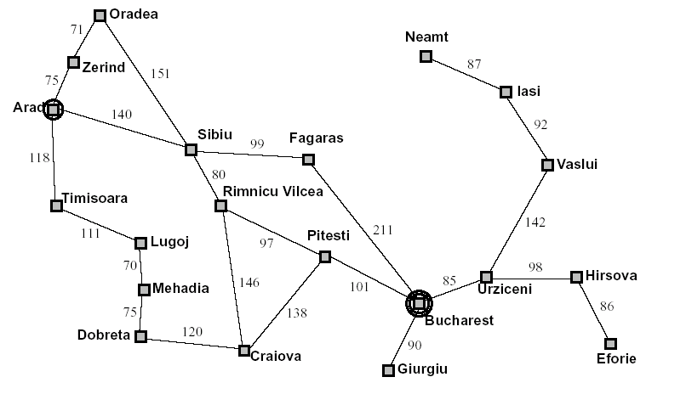
Problem Formulation - Romania
Start
Finish

Slide 10

Problem Formulation - Romania
Initial State ➔ Arad
Goal State ➔ Bucharest
Operator
➔ Driving between cities
State Space
➔ All 20 cities in the graph
Goal Test
➔ Is the current state Bucharest?
A solution is a path from the initial to the goal state
Path cost is a function of time/distance/risk/petrol/…
What is the neighbourhood of Arad?

Slide 11
Problem Formulation – (8-Puzzle)
1
4
3
1
2
3
1
2
3
1
4
7
7
6
8
4
4
5
6
2
5
8
5
8
2
7
6
5
7
8
3
6
Goal States
Initial State
1
2
3
8
4
7
6
5

Slide 12

Problem Formulation – (8-Puzzle)
States
specifies the location of each of the eight tiles and the blank in one of the nine squares
Operators
Each number moves left, right, up or down
Or better, blank tile moves left, right, up or down
Goal Test
the current state matches a certain state (e.g. one of the goal states shown on the previous slide)
Path Cost
each move of the blank costs 1
How big is the state space? n!/2 it can be reduced dramatically with a good problem formulation

Slide 13
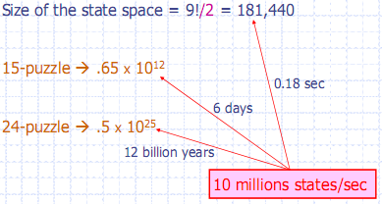
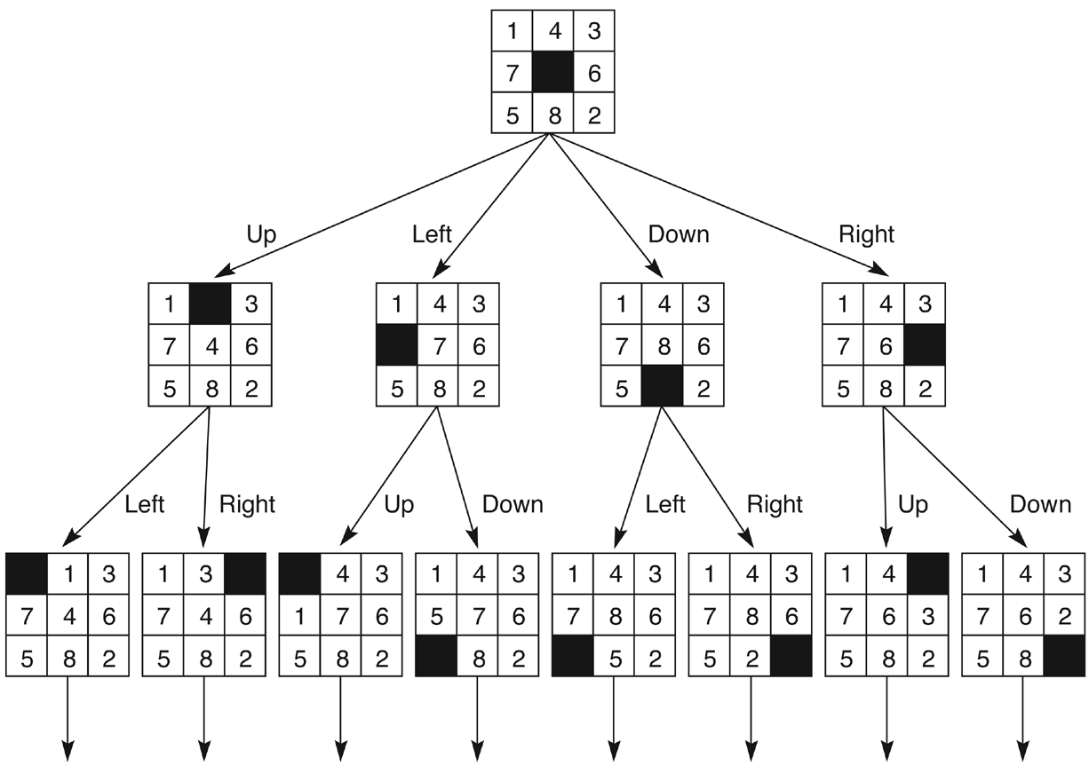
state space– (8-Puzzle)

Slide 14
Problem Formulation – (8-Queen)
Initial state: an empty board
Operator: add a queen into a square on the board
States: any arrangement of 0 to 8 queens on the board
Goal state: an arrangement of 8 queens on board with none attacked queens

Slide 15
Problem Formulation – (8-Queen)
1st Formulation: Add a queen to any empty square
Q
 | Q |  |  | Q
Q
 |  |  |  |  | Q
 |  | Q
 |  |  |  |  | Q
 |  |  | Q
How big is the state space? 64*63*62*61*60*59*58*57=
1.78E+14

Slide 16
Problem Formulation – (8-Queen)
2nd Formulation: Add a queen to any square in the leftmost empty column
Q |  |  |  |  |  | Q
 |  |  |  | Q
 | Q
 |  | Q |  |  | Q
 |  |  | Q
 |  |  |  |  |  |  | Q
How big is the state space? 8*8*8*8*8*8*8*8=
16,777,216

Slide 17
Problem Formulation – (8-Queen)
3rd Formulation: Add a queen to any square in the leftmost empty column such that it is not attacked by any other queen (if possible)
Q
 |  |  |  | Q
 | Q
 |  |  |  |  | Q
 |  | Q
 |  |  |  |  |  | Q
 |  |  | Q
 |  |  |  |  |  |  | Q
How big is the state space? 8*6*4*3*2*1*1*8=9216

Slide 18
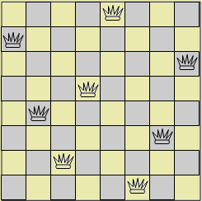
One possible solution – (8-Queen)

Slide 19
Problem Representation
The elements of problem formulation can be gathered together into a single data structure as input to a problem solving agent
Datatype PROBLEM
Components
INITIAL-STATE,
OPERATORS,
GOAL-TEST,
PATH-COST-FUNCTION

Slide 20


State Space Representation
We can use graphs to model the deeper structure of a problem → state space graphs
A graph consists of a set V of nodes, and a set E of edges
Nodes
have a unique label for identification
represent possible stages of a problem
Edges
connection between two nodes
represent inferences, moves in a game, or other steps in a problem solving process

Slide 21
State Space Trees
A tree is a graph that:
is connected but becomes disconnected on removing any edge
is connected and acyclic
has precisely one path between any two nodes
Property 3, unique paths, makes them much easier to search so that we will start with a search on (rooted) trees

Slide 22
State Space Graphs/Trees
B
A
F
D
C
A Tree
B
E
G
A
F
D
A Graph
I
C
H
E
G
J

Slide 23

Trees - Terminologies
Nodes
Root Node
Children Node
Parent Node
Leaves
Branching Factor
Average number of children of nodes in the tree
The depth, d, of a node is just the number of edges it is away from the root node
The depth of a tree is the depth of the deepest node
in this case, depth=4
The number of nodes = (b^{(d+1)}-1)/(b-1)
This is the maximum number of nodes when b is the same
When b is different for the nodes then we use the same equation and b becomes the average branching factor
d=0
F
d=1
B
J
C
H
E
G
d=2
A
I
d=3
D
d=4

Slide 24
State Space Tree – Romania
Arad
Sibiu
Timisoara
Zerind
…
…
Arad
Fagaras
Oradea
Rimnicu
Vilcea
…
…
Sibiu
Bucharest

Slide 25
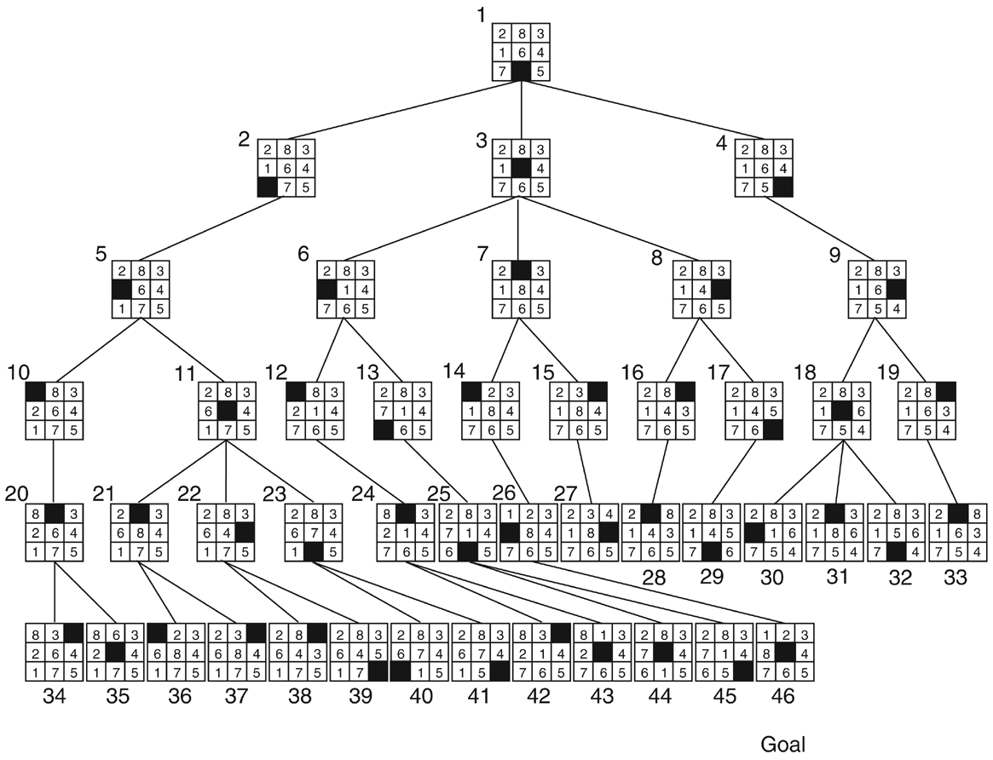
State Space Tree – 8-Puzzle (Implicit)

Slide 26
State Space Tree – Tic-Tac-Toe

Slide 27
State Space Tree – Tic-Tac-Toe
x
x
x
x
x
x
x
x
x
o
………..
o
x
x
x
x
o

Slide 28
State Space Trees – 8-queen
1st level: 1 root node (empty board)
2nd level: 8 nodes
3rd level:6 nodes for each node on previous level
4th level:4 nodes for each node on previous level
5th level:2 nodes for each node on previous level
6th level:1 node for each node on previous level
7th level:1 node for each node on previous level
8th level:8 nodes for each node on previous level

Slide 29
Traveling salesperson problem as state space search
The salesperson has n cities to visit and must then return home. Find the shortest path to travel.
state space:
operators:
initial state:
goal state:

Slide 30
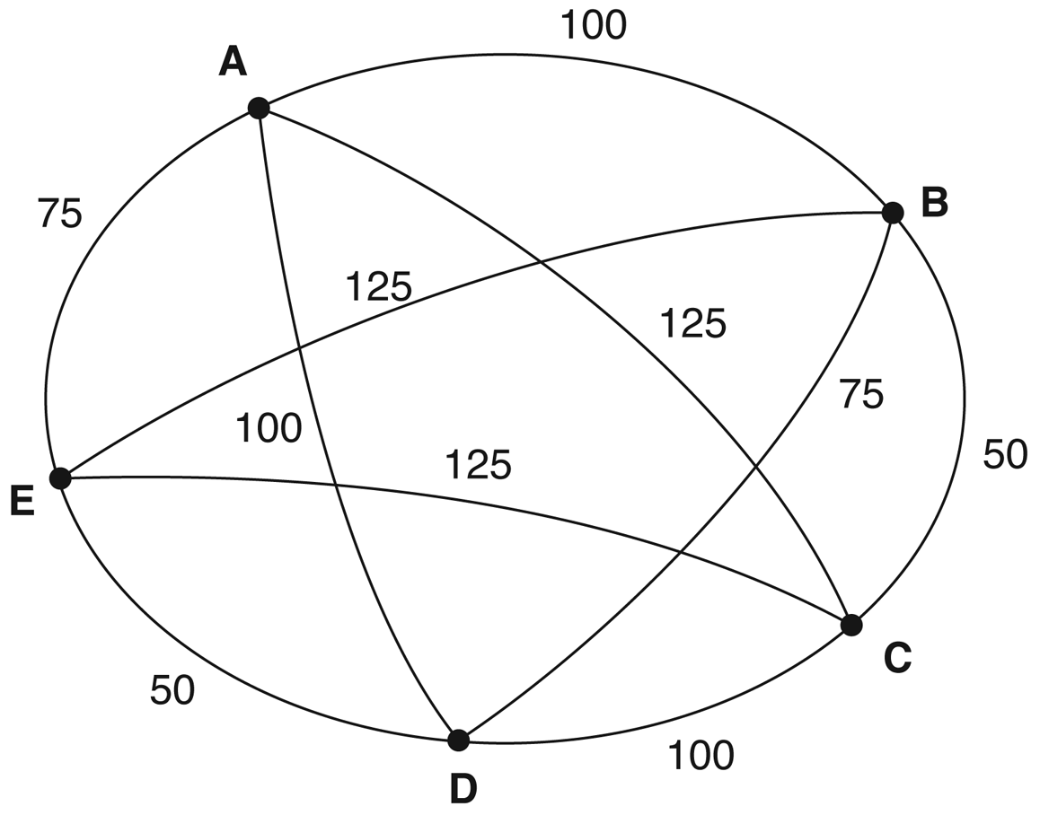
An instance of the traveling salesperson problem

Slide 31
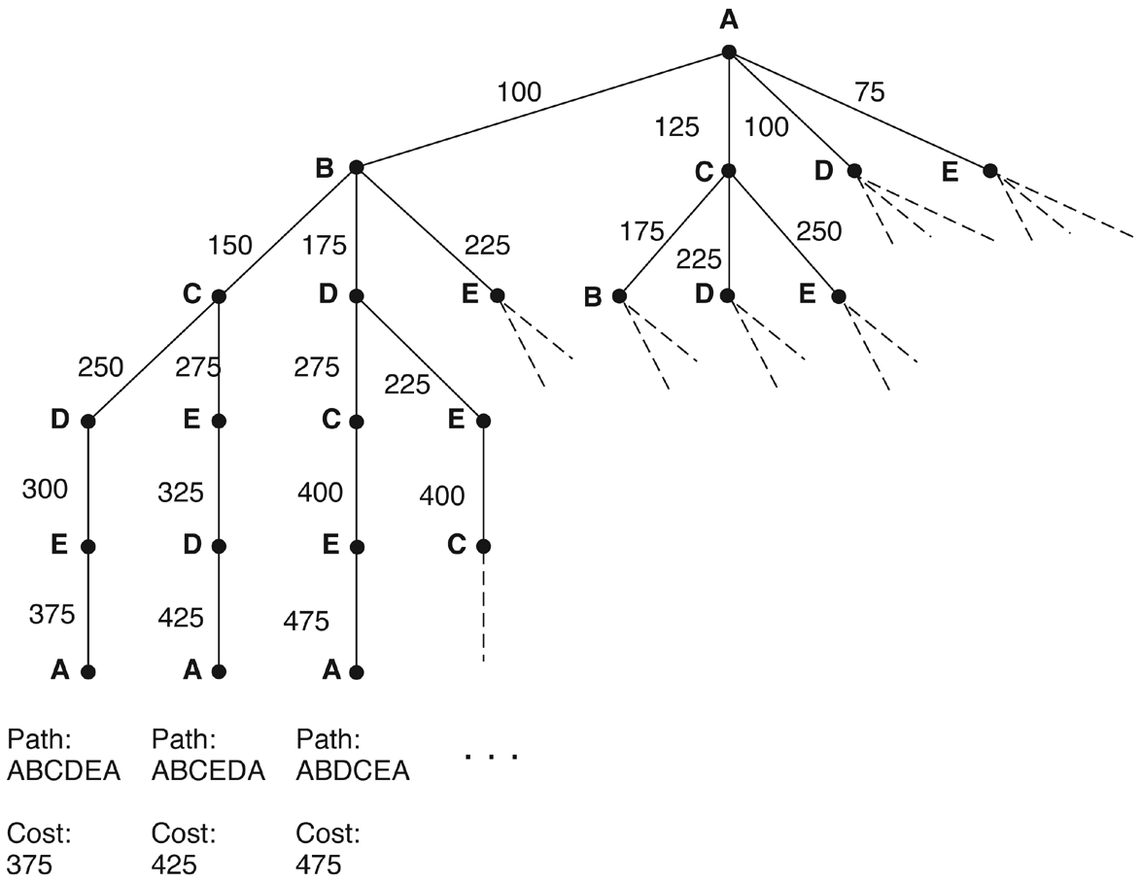
Search of the traveling salesperson problem. (arc label = cost from root)

Slide 32
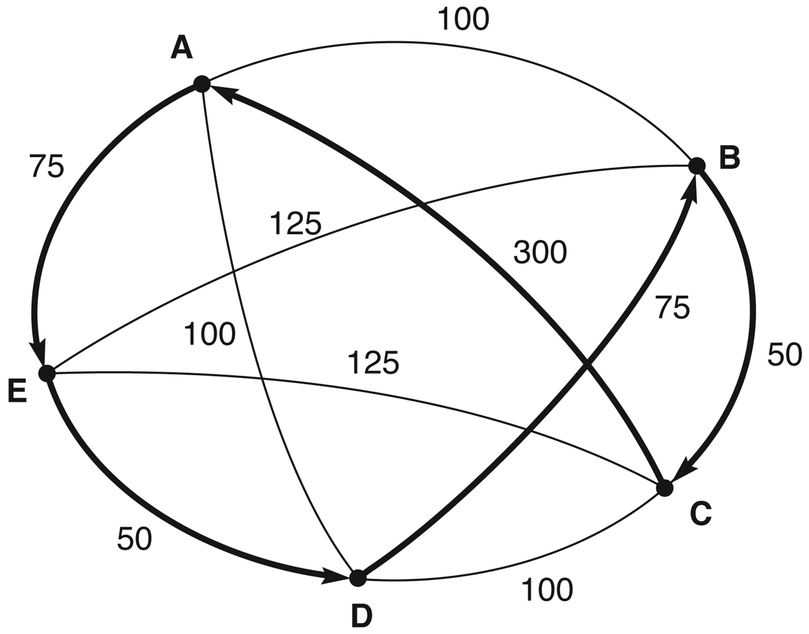
Nearest neighbor path
Nearest neighbor path = AEDBCA (550)
Minimal cost path = ABCDEA (375)

Slide 33


State Space – Exercises
Tower of Hanoi
Formulate this problem. Suggest an appropriate representation and draw the corresponding state space, ignoring cyclic paths.
Missionaries and Cannibals
Three missionaries and three cannibals are on one side of a river, with a canoe. They all want to get to the other side of the river. The canoe can only hold one or two people at a time. At no time should there be more cannibals than missionaries on either side of the river, as this would probably result in the missionaries being eaten. Formulate this problem and with appropriate representation, draw the state space.

Slide 34
Searching the State Space
Representing the entire space of problems as state space graphs/trees provides a powerful tool for measuring the structure and complexity of problems and analyzing the efficiency, correctness and generality of solution strategies
Problem solving is a process of searching the state space graphs/trees for a path to a solution
The choice of which state to expand is determined by the search strategy
The corresponding sequences of state expansion is represented by a data structure known as a search tree

Slide 35
Finding Goals in Trees
Does the following tree contain a node “I”?
Yes. How did you know that?
“read it”?
“Trivial!”: so why the big deal about search?
B
A
F
D
I
C
H
E
G
J

Slide 36
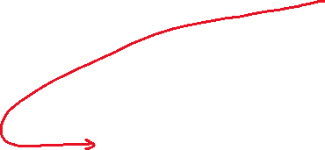

Why is Goal Search Not Trivial?
Because the graph/tree is not given in a nice picture “on a piece of paper”
At the start of the search, the search algorithm does not know
the size of the tree
the shape of the tree
the depth of the goal states
How big can a search tree be?
say there is a constant branching factor b
and one goal exists at depth d
search tree which includes a goal can have approximately b^{d} different branches in the tree (worst case)
Examples:
b = 2, d = 10: b^{d} = 2¹⁰= 1024
b = 10, d = 10: b^{d} = 10¹⁰= 10,000,000,000

Slide 37
Finding Goals in Trees: Reality
Does the tree under the following root contain a node “G”?
All you get to see at first is the root node
and a guarantee that it is a tree
The rest is up to you to discover during the process of search → discover/create “on the fly”
F

Slide 38



Properties of Search
We will say a search method is “complete” if it has both the following properties:
if a goal exists then the search will always find it
if no goal exists then the search will eventually finish and be able to say for sure that no goal exists

Slide 39
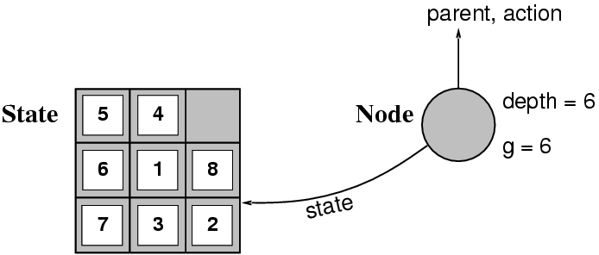
Implementation: Representation
A node is a data structure constituting part of a search tree containing information such as: state, parent node, action, path cost g(x), depth
A state is the configuration in the state space to which the node corresponds
The Successor-Fn(x) (successor function) returns all states that can be reached from state x

Slide 40
Implementation: Node Representation
Datatype NODE
Components:
STATE,
PARENT-NODE,
DEPTH,
PATH-COST
State
This represents the state in the state space to which a node corresponds
Parent-Node
This points to the node that generated this node. In a data structure representing a tree it is usual to call this the parent node
Depth
The number of nodes from the root
Path-Cost
The path cost from the initial state to this node

Slide 41
How Good is a Solution?
Does our search method actually find a solution?
Is it a good solution?
Path Cost
Search Cost (Time and Memory)
Does it find the optimal solution?
But what is optimal?

Slide 42





Evaluating a Search
Completeness
Is the strategy guaranteed to find a solution?
Time Complexity
How long does it take to find a solution?
Space Complexity
How much memory does it take to perform the search?
Optimality
Does the strategy find the optimal solution where there are several solutions?

Slide 43
Uninformed Search Strategies

Slide 44
Blind Search strategies or Uninformed search
Blind search or uninformed search – which does not use any extra information about the problem domain
Uninformed search strategies include:
Depth first search
Breadth first search
Iterative deepening search (not in this course)
Iterative broadening search (not in this course)

Slide 45


Breadth-First Search (BFS)
Expands Root node first, then all successors, then their successors and so on. (FIFO Queue)
Complete - when branching factor is finite
Optimal - when path cost is non-decreasing function of depth
Memory requirements are a bigger problem than execution time.
Execution time is still a major factor
Problems of Exponential Complexity cannot be solved by uninformed search for any but the smallest instances.

Slide 46
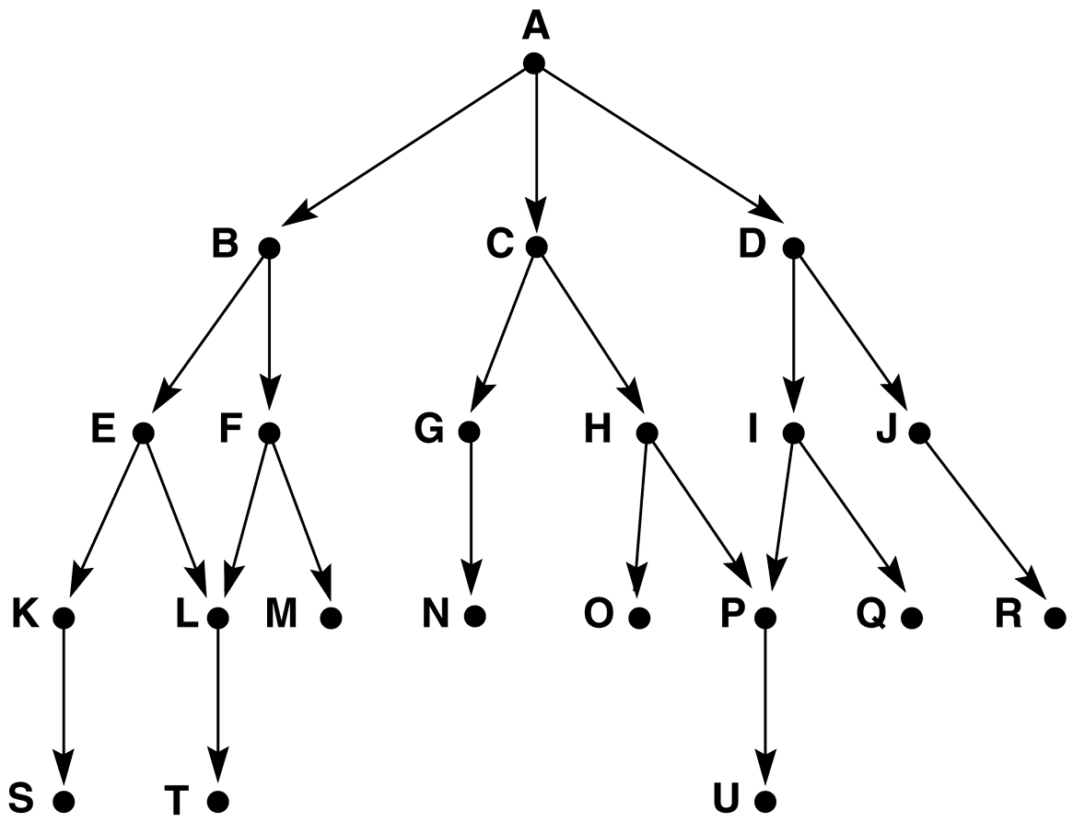
Graph for BFS and DFS (Fig. 1)

Slide 47
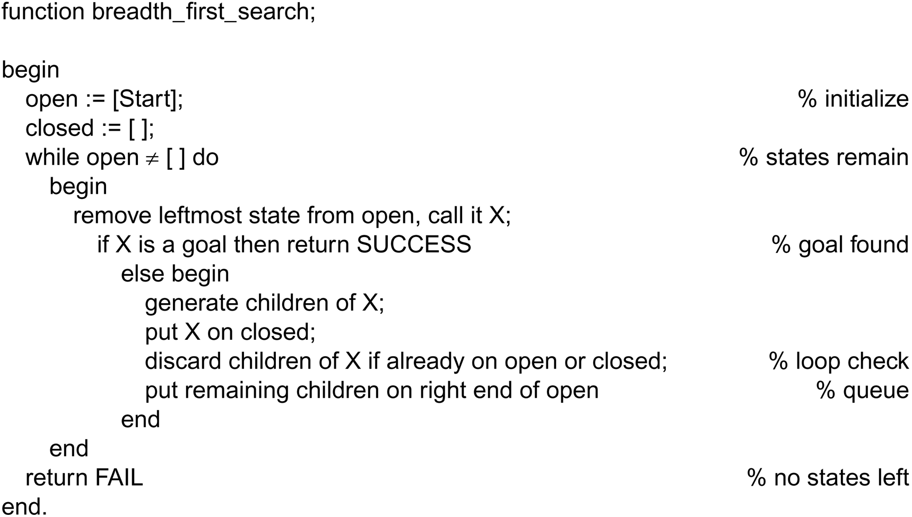
Breadth_first search algorithm

Slide 48
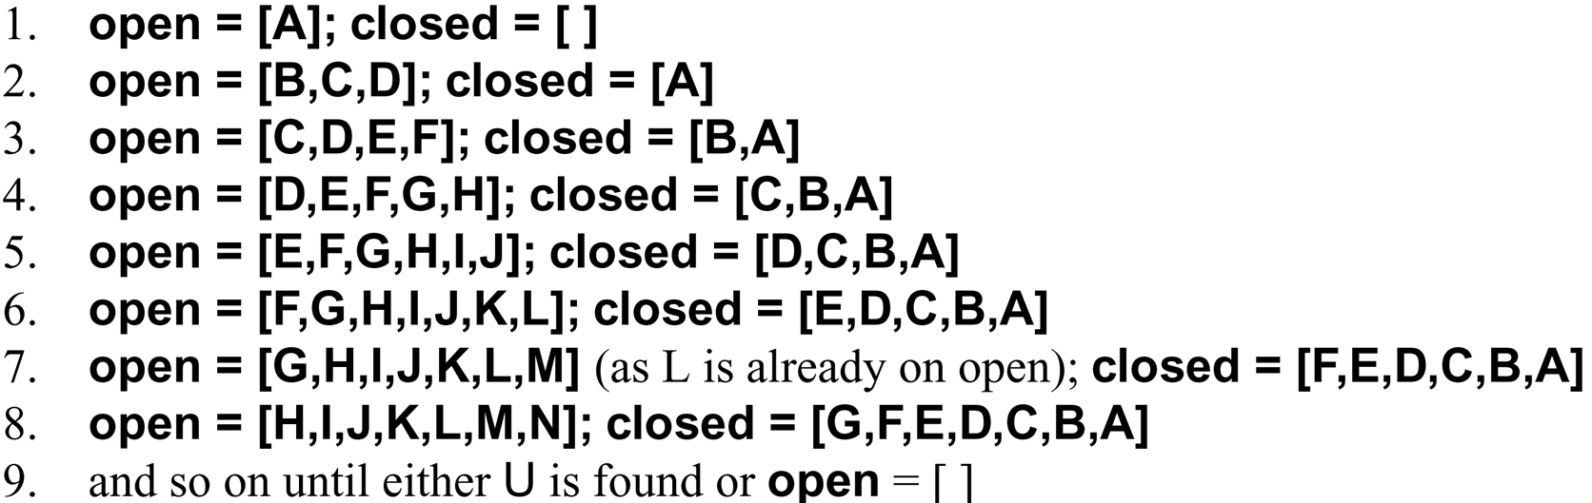
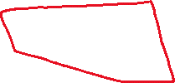
Trace of BFS on the graph of Fig. 1

Slide 49
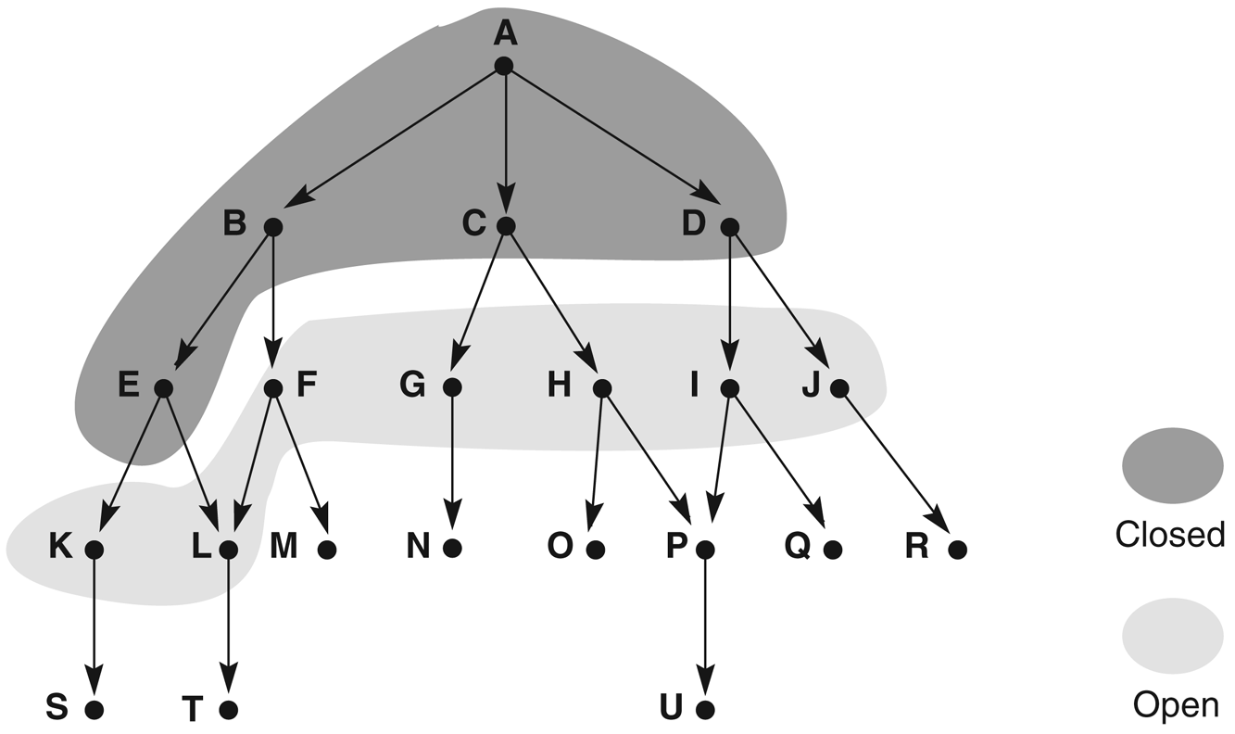
Graph of Fig. 1 at iteration 6 of BFS

Slide 50
BFS, label = order state was removed from OPEN

Slide 51
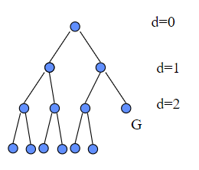

Properties of breadth-first search
We assume that every non-leaf node has b children. Suppose that d is the depth of the shallowest goal node
Complete? Yes (if b is finite)
Time? 1+b+b²+b³+… +b^{d} = O(b^{d})
Space? O(b^{d}) (keeps every node in memory)
Optimal? Yes (if cost = 1 per step)
Space is the bigger problem (more than time)

Slide 52
BFS using python for 8-puzzle
import queue
import numpy as np
import copy
class Node:
def __init__(self, state, parent=None):
self.state = state
self.parent = parent
self.goal = np.array([[1, 2, 3], [4, 5, 6], [7, 8, 0]])
def is_goal_state(self):
return np.array_equal(self.state, self.goal)
def fetch(self):
r, c = np.squeeze(np.where(self.state == 0))
valid_moves = []
moves = [(r + 1, c), (r - 1, c), (r, c - 1), (r, c + 1)]
for i in moves:
if ((i[0] >= 0) and (i[0] < 3)) and ((i[1] >= 0) and (i[1] < 3)):
valid_moves.append(i)
childs = []
for move in valid_moves:
new = copy.deepcopy(self.state)
new[r, c], new[move] = new[move], new[r, c]
childs.append(new)
return childs

Slide 53
Cont
class BFS:
def __init__(self, initial_state):
self.initial_state = initial_state
self.visited = set() def solve(self):
initial_node = Node(self.initial_state)
q = queue.Queue()
q.put(initial_node) while not q.empty():
current_node = q.get() if current_node.is_goal_state():
solution_path = self.reconstruct_path(current_node)
print('A solution has been found')
return solution_path
if tuple(current_node.state.flatten()) in self.visited:
continue
child_states = current_node.fetch()
self.visited.add(tuple(current_node.state.flatten()))
for child_state in child_states:
if tuple(child_state.flatten()) not in self.visited:
child_node = Node(child_state, parent=current_node)
q.put(child_node) return None def reconstruct_path(self, node):
solution_path = []
while node is not None:
solution_path.append(node.state)
node = node.parent
solution_path.reverse()
return solution_path
if __name__ == "__main__":
fake_state = np.array([[1, 5, 0], [4, 6, 3], [2, 7, 8]])
solver = BFS(fake_state)
solution = solver.solve()
if solution:
print("Solution steps:")
for index, state in enumerate(solution):
print(f"Step {index + 1}:")
print(state)
print("----------------")
else:
print("No solution found.")

Slide 54
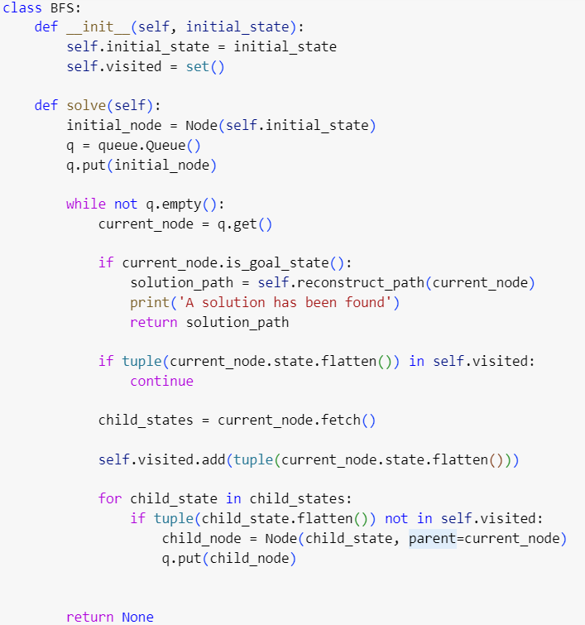
Visited nodes
The previous implementation might be slow, why?
Some nodes (states) are being visited many times
It is good practice to keep track of the visited nodes so the algorithm won't visit it again
The added line to the algorithm will increase the efficiency significantly

Slide 55
Depth-first search (DFS)
Expands the deepest node in the current
branch of the tree. (LIFO Queue, Stack)
Modest memory requirements
Not optimal, it explores one path to its end, thereby possibly finding a solution that is more expensive than some solution in another path!
Not complete unless the depth is limited

Slide 56
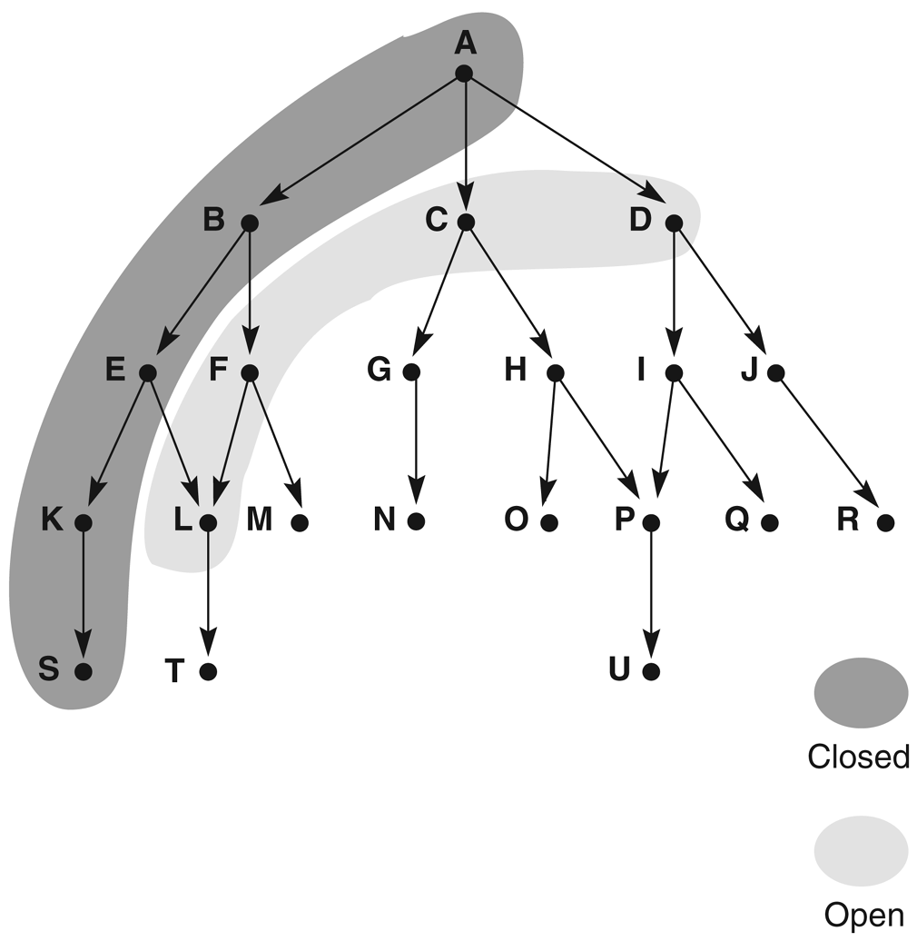
Graph of Fig. 1 at iteration 6 of DFS

Slide 57
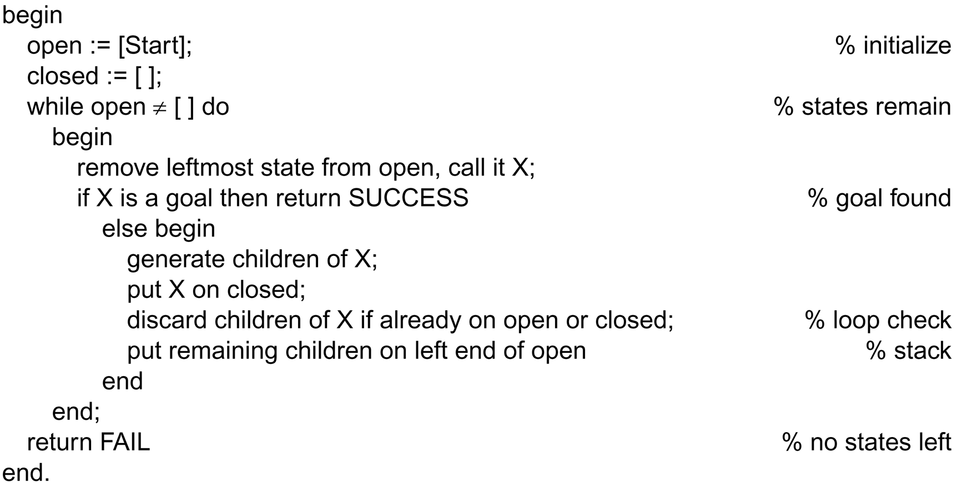
Depth_first_search algorithm

Slide 58
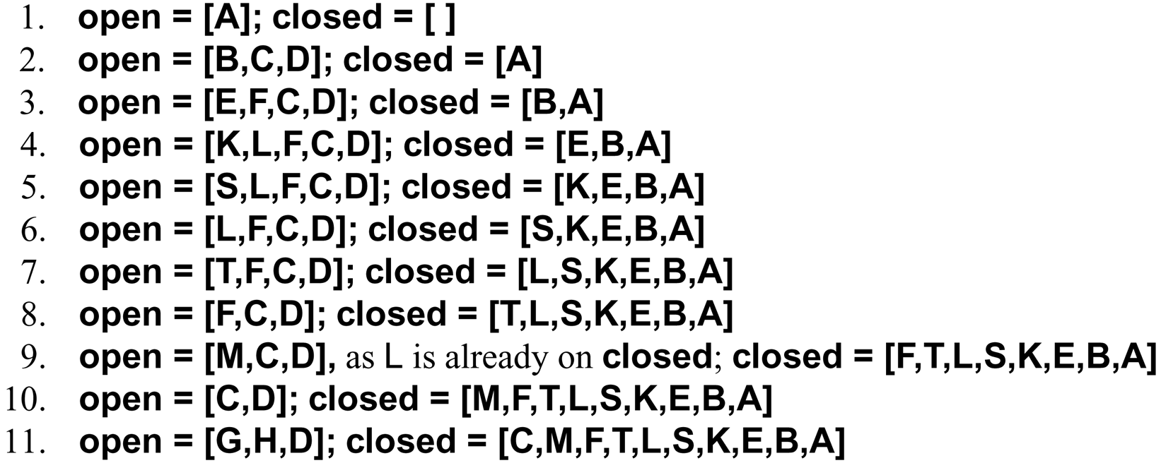
Trace of DFS on the graph of Fig. 1

Slide 59
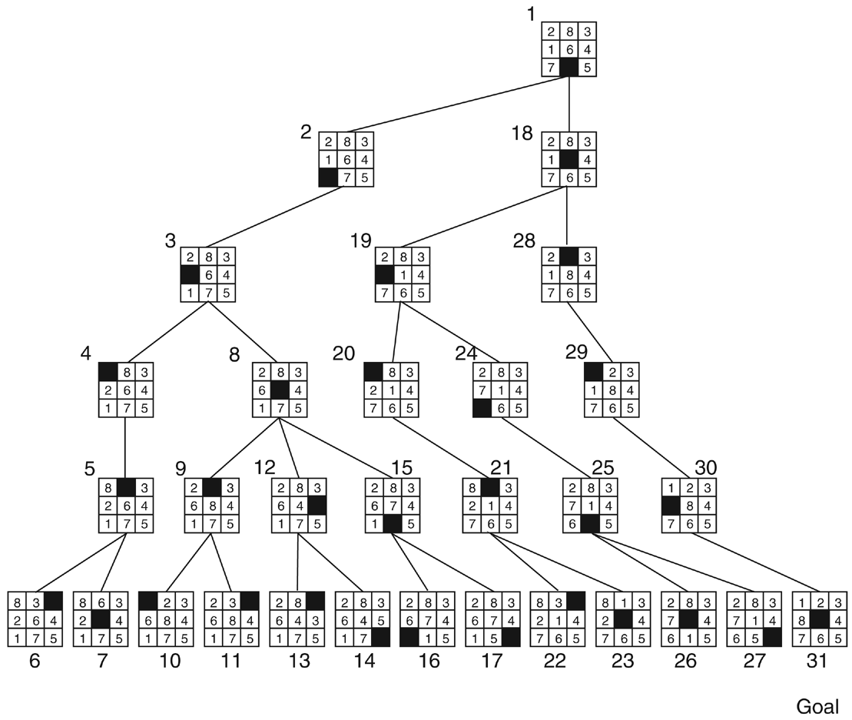
DFS with a depth bound of 5, label = order state was removed from OPEN

Slide 60
Properties of depth-first search
Suppose that d is the depth of the shallowest goal node and m is the depth of deepest node opened.
Complete? No: fails in infinite-depth spaces, spaces with loops
Modify to avoid repeated states along path
→ complete in finite spaces
Time? O(b^{m}): terrible if m is much larger than d
but if solutions are dense, may be much faster than breadth-first
Space? O(bm), i.e., linear space!
Optimal? No

Slide 61
Informed Search Strategies

Slide 62

Introduction
Some people believe that they are good at solving hard problems without search,
However, consider e.g., public key encryption codes (or combination locks): The search problem is clear, but people can’t solve it
When people do perform well on hard problems, it is usually because they have useful knowledge about the structure of the problem domain
Computers can also improve their performance when given this sort of knowledge
In search, they can estimate the distance from a given node to the goal through a search heuristic.
In this way, they can take the goal into account when selecting path

Slide 63
Introduction
Heuristic search techniques include:
Greed best-first search
A* search
Simulated annealing search
Hill-climbing search
Local beam search
Genetic algorithms

Slide 64
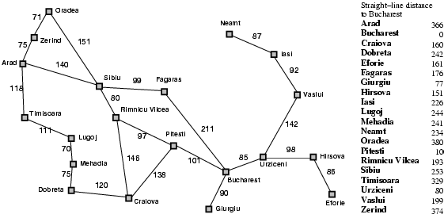
Romania with step costs in km

Slide 65

Greedy best-first search
Evaluation function f(n) = h(n) (heuristic)
estimation of the cost from n to goal
e.g., h_{SLD}(n) = straight-line distance from n to Bucharest
Greedy best-first search expands the node that appears to be closest to goal

Slide 66

Greedy best-first search example

Slide 67
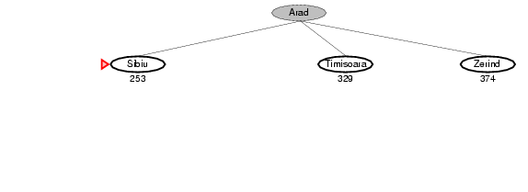
Greedy best-first search example

Slide 68
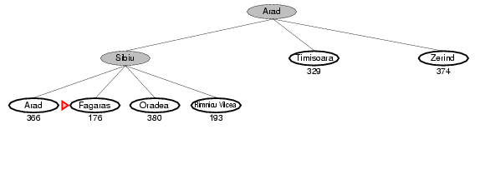
Greedy best-first search example

Slide 69
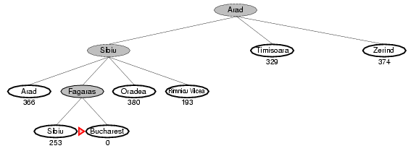
Greedy best-first search example

Slide 70


Properties of greedy best-first search
Complete? No – can get stuck in loops, e.g. Consider the problem of getting from Iasi to Fagaras.
Iasi → Neamt → Iasi → Neamt → Iasi → infinite loop
Time? O(b^{m}), but a good heuristic can give dramatic improvement
Space? O(b^{m}) -- keeps all nodes in memory
Optimal? No

Slide 71

A* search
Idea: avoid expanding paths that are already expensive
Evaluation function f(n) = g(n) + h(n)
g(n) = cost so far to reach n
h(n) = estimated cost from n to goal
f(n) = estimated total cost of path through n to goal

Slide 72
Romania with step costs in km

Slide 73

A* search example

Slide 74
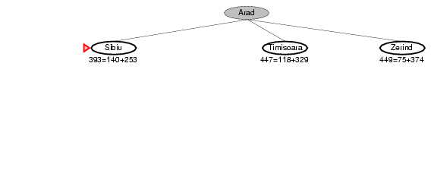
A* search example

Slide 75
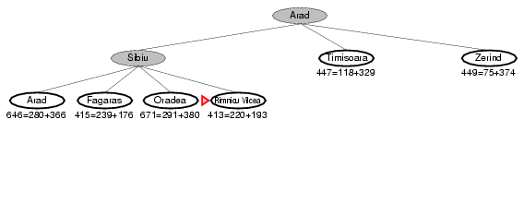
A* search example

Slide 76
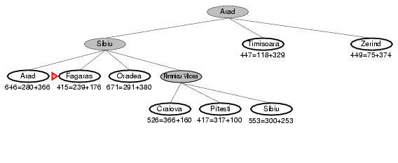
A* search example

Slide 77
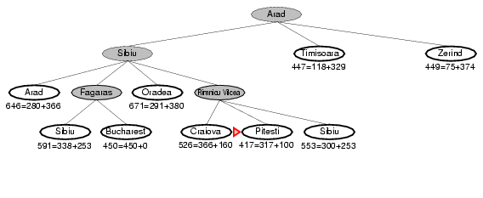
A* search example

Slide 78
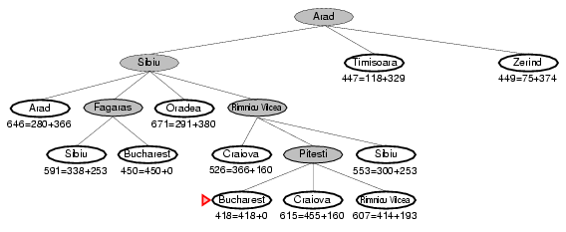
A* search example

Slide 79



Admissible heuristics
A heuristic h(n) is admissible if for every node n,
h(n) ≤ h*(n), where h*(n) is the true cost to reach the goal state from n.
An admissible heuristic never overestimates the cost to reach the goal, i.e., it is optimistic
Example: h_{SLD}(n) (never overestimates the actual road distance) Theorem: If h(n) is admissible, A* using TREE-SEARCH is optimal

Slide 80
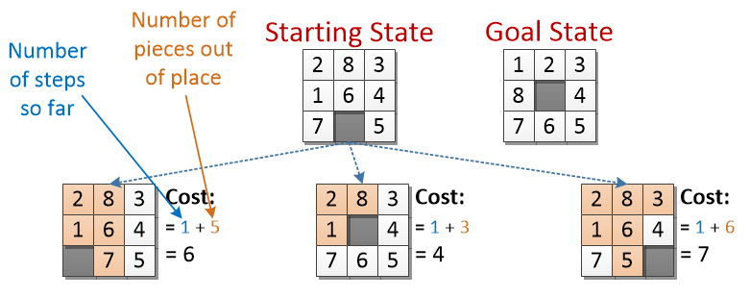
8-puzzle
8-puzzle can be solved for the optimal solution using A* algorithm
Can you think of the heuristic?
One can use the number of out-position tails as a cost for each state

Slide 81
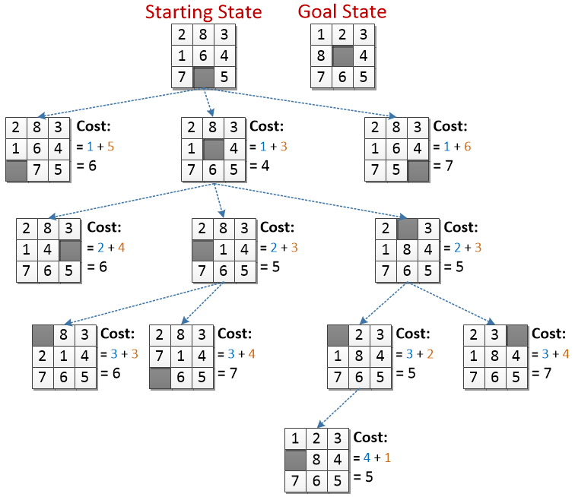


Cont.

Slide 82


Genetic algorithms
A successor state is generated by combining two parent states
Start with k randomly generated states (population)
A state is represented (not necessarily) as a string over a finite alphabet (often a string of 0s and 1s)
Evaluation function (fitness function). Higher values for better states.
the fitness can be maximum benefit or minimum cost
Produce the next generation of states by selection, crossover, and mutation

Slide 83
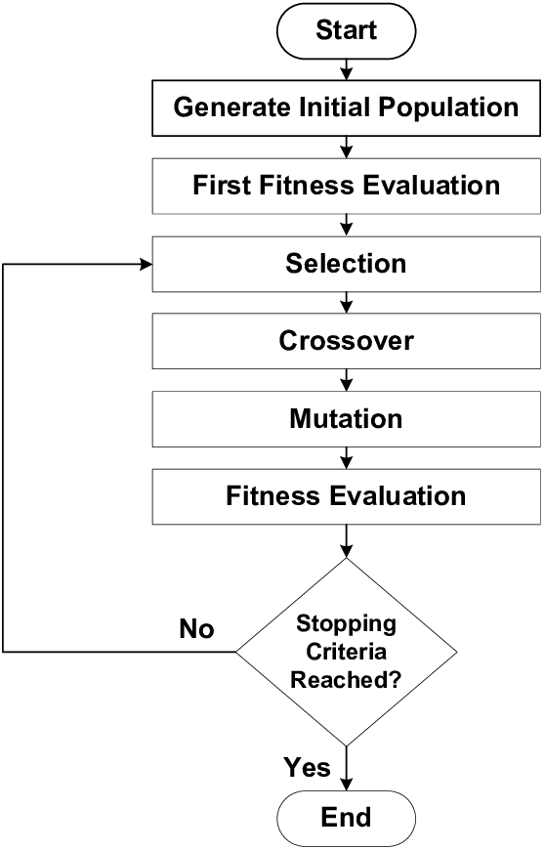

GA flow-chart diagram
Typical GA goes through the following stages

Slide 84
Example: N-queens problem
Traditional problem of placing N non-attacked queens on a board
i.e., no two queens threaten each other
There are 4,426,165,368 combinations
n! / ((n - k)! * k!) => 64! / ((64 - 8)! * 8!)
There are only 92 distinct solutions

Slide 85
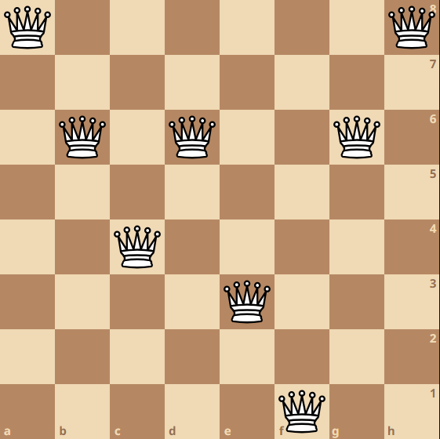

GA
First step in GA is to initiate a population
A state can be represented as array has values from 0-7
Each element in the array represent the row on which the queen is placed
The index represent the column
One possible state is represented in the figure =>
[0, 2, 4, 2, 5, 7, 2, 0]

Slide 86

Population creation
The population is set of random states, let us say our population has size of 4 (for illustration), then the population can be represented as a list of states.
E.g.,
In python, this can be done using the following code
[
[0, 2, 4, 2, 5, 7, 2, 0],
[4, 1, 4, 1, 5, 6, 2, 1],
[2, 0, 3, 6, 4, 7, 8, 2],
[3, 2, 7, 2, 5, 1, 2, 7]
]
pop= np.random.randint(low=0, high=8, size=(4, 8),dtype=np.int8)
2D NumPy array of shape 4 (population size)
8 is the number of queens

Slide 87

Evaluation
After creating the population, we need to evaluate each individual in this population
See how much each state is good.
This is done by the help of fitness function
The fitness function differs from one problem to another
In the 8-queen problem the fitness might be the number of queens which attack each other
Let us take the first state from our population
[0, 2, 4, 2, 5, 7, 2, 0]

Slide 88

Fitness
Penalty: 0
[0, 2, 4, 2, 5, 7, 2, 0]

Slide 89
Fitness
Penalty: 1
[0, 2, 4, 2, 5, 7, 2, 0]

Slide 90
Fitness
Penalty: 2
[0, 2, 4, 2, 5, 7, 2, 0]

Slide 91
Fitness
Penalty: 3
[0, 2, 4, 2, 5, 7, 2, 0]

Slide 92
Fitness
Penalty: 4
[0, 2, 4, 2, 5, 7, 2, 0]

Slide 93
Fitness
Penalty: 5
[0, 2, 4, 2, 5, 7, 2, 0]

Slide 94
Fitness
Penalty: 6
[0, 2, 4, 2, 5, 7, 2, 0]

Slide 95
Fitness
Penalty: 7
[0, 2, 4, 2, 5, 7, 2, 0]

Slide 96
Fitness
Penalty: 8
[0, 2, 4, 2, 5, 7, 2, 0]

Slide 97
Fitness
Penalty: 9
[0, 2, 4, 2, 5, 7, 2, 0]

Slide 98
Fitness
Penalty: 10
[0, 2, 4, 2, 5, 7, 2, 0]

Slide 99
Fitness
Penalty: 11
[0, 2, 4, 2, 5, 7, 2, 0]

Slide 100
Fitness
Penalty: 12
[0, 2, 4, 2, 5, 7, 2, 0]

Slide 101
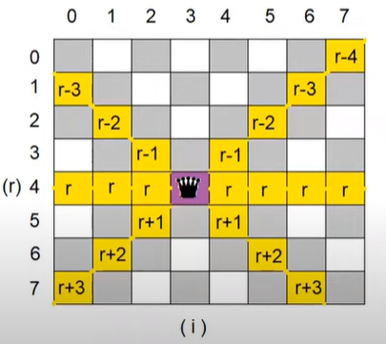
Fitness
So, we need to check for each queen if it attacks other queens (horizontally, vertically or diagonally)
def fitness(state):
p = 0
for i in range(8):
for j in range(8):
if i !=j:
d = abs(i-j)
r = state [i]
if state[j] in [r,r-d,r+d]:
p = p + 1
return p/2 % no need for the reflection

Slide 102
Evaluation: cont.
def evaluate(pop):
scores = []
for i in pop:
scores.append(fitness(i))
return np.array(scores)

Slide 103

Selection
Not the whole population is of our interest, we select a percent (best) of the population to create the new generation (survival for the fittest). أصلح
We sort the states based on the penalty score
We consider 50% of the population
scores = evaluate(population)
scoresSorted = np.argsort(scores)
scores = scores[scoresSorted]
populationSorted = population[scoresSorted]
popPercent = 0.5
toTake = np.int64(np.round(popSize*popPercent))
bestPop = populationSorted[0:toTake]

Slide 104
Sort and select
Sorted in an increasing order so the best states comes first
States (population)
[
[0, 2, 4, 2, 5, 7, 2, 0],
[4, 1, 4, 1, 5, 6, 2, 1],
[2, 0, 3, 6, 4, 7, 8, 2],
[3, 2, 7, 2, 5, 1, 2, 7]
]
Scores
[
6
7
5
8
]
Selected states
[
[2, 0, 3, 6, 4, 7, 8, 2],
[0, 2, 4, 2, 5, 7, 2, 0]
]
Sorting
States (population)
[
[2, 0, 3, 6, 4, 7, 8, 2],
[0, 2, 4, 2, 5, 7, 2, 0], [4, 1, 4, 1, 5, 6, 2, 1],
[3, 2, 7, 2, 5, 1, 2, 7]
]
Scores
[
5
6
7
8
]

Slide 105
Crossover
We use the selected states to create a new states (solutions)
We use what is called crossover
Simply select a cutting point and mix the genes to produce new children
assume the cut point was 4 (randomly selected)
Another cutting point (say 2)
Father [2, 0, 3, 6, 4, 7, 8, 2] Mother[0, 2, 4, 2, 5, 7, 2, 0]
Our new population
[
[2, 0, 3, 6, 5, 7, 2, 0],
[0, 2, 4, 2, 4, 7, 8, 2],
[2, 0, 4, 2, 5, 7, 2, 0],
[0, 2, 3, 6, 4, 7, 8, 2]
]
Child1 [2, 0, 3, 6, 5, 7, 2, 0] Child2 [0, 2, 4, 2, 4, 7, 8, 2]
Father [2, 0, 3, 6, 4, 7, 8, 2] Mother[0, 2, 4, 2, 5, 7, 2, 0]
Child1 [2, 0, 4, 2, 5, 7, 2, 0] Child2 [0, 2, 3, 6, 4, 7, 8, 2]

Slide 106
Code
We repeat this in a loop to fill the new population
Random parents are selected from the population
parents = np.random.choice(np.arange(0, bestPop.shape[0]), size=2, replace=False)
father = parents[0]
mother = parents[1]
crom1 = bestPop[father]
crom2 = bestPop[mother]
cut = np.random.randint(3,5)
child1 = np.concatenate((crom1[0:cut],crom2[cut:]))
child2 = np.concatenate((crom2[0:cut],crom1[cut:]))

Slide 107
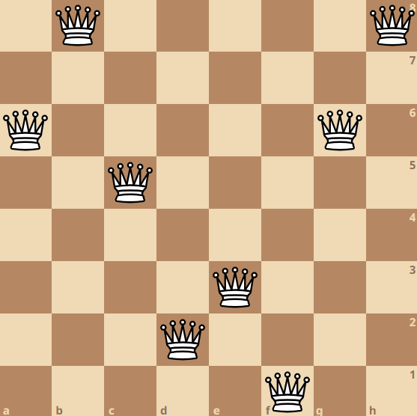
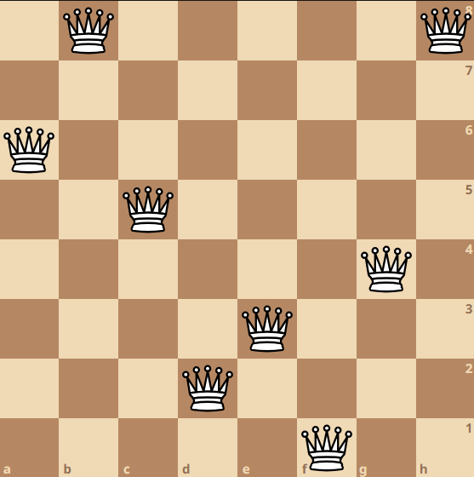
Mutation
Mutations happens in nature
It helps to create creatures able to survive more
In GA Mutations helps to exit local optimums
[2, 0, 3, 6, 5, 7, 2, 0]
if np.random.uniform() < 0.1:
toChange = np.random.randint(0,8)
child1[toChange] = np.random.randint(0,8)
if np.random.uniform() < 0.1:
toChange = np.random.randint(0,8)
child2[toChange] = np.random.randint(0,8)
[2, 0, 3, 6, 5, 7, 4, 0]

Slide 108
Repeat
The previous stages are repeated until a solution is found
We usually keep track of the best state from every generation
Follows the full code using python

Slide 109
class GA:
def __init__(self,popSize, numGen, mutPercent=0.1,nqueens=8):
self.popSize = popSize
self.nqueens = nqueens
self.numGen = numGen
self.mutPercent = mutPercent
def initial_pop(self):
pop= np.random.randint(low=0, high=self.nqueens, size=(self.popSize, self.nqueens),dtype=np.int8)
return pop
def fitness(self,state):
p = 0
for i in range(self.nqueens):
for j in range(self.nqueens):
if i !=j:
d = abs(i-j)
r = state [i]
if state[j] in [r,r-d,r+d]:
p = p + 1
return p/2
def evaluate(self,pop):
scores = []
for i in pop:
scores.append(self.fitness(i))
return np.array(scores)
def solve(self):
population = self.initial_pop()
gen = 0
while (gen <= self.numGen):
generation = []
scores = self.evaluate(population)
scoresSorted = np.argsort(scores)
scores = scores[scoresSorted]
populationSorted = population[scoresSorted]
popPercent = 0.6
toTake = np.int64(np.round(self.popSize*popPercent))
bestPop = populationSorted[0:toTake]
bestState = bestPop[0]
bestCost = scores[0]
if bestCost == 0:
print(f"A solution was found: {bestState} with cost {bestCost}")
return bestState

Slide 110
j=0
while (j <= self.popSize):
parents = np.random.choice(np.arange(0, bestPop.shape[0]), size=2, replace=False)
father = parents[0]
mother = parents[1]
crom1 = bestPop[father]
crom2 = bestPop[mother]
cut = np.random.randint(3,5)
child1 = np.concatenate((crom1[0:cut],crom2[cut:]))
child2 = np.concatenate((crom2[0:cut],crom1[cut:]))
if np.random.uniform() < self.mutPercent:
toChange = np.random.randint(0,self.nqueens)
child1[toChange] = np.random.randint(0,self.nqueens)
if np.random.uniform() < self.mutPercent:
toChange = np.random.randint(0,self.nqueens)
child2[toChange] = np.random.randint(0,self.nqueens)
generation.append(child1)
generation.append(child2)
j=j+1
population = np.array(generation)
gen = gen + 1
print ('No solution was found! Restart')
return None
Run the code using the following:
solver = GA (400,500,0.15)
solution= solver.solve()

Slide 111
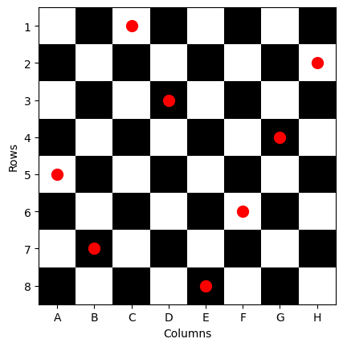
import matplotlib.pyplot as plt
chessboard = np.zeros((8, 8), dtype=int)
chessboard[1::2, ::2] = 1
chessboard[::2, 1::2] = 1
plt.imshow(chessboard, cmap='binary')
plt.xticks(np.arange(8), ['A', 'B', 'C', 'D', 'E', 'F', 'G', 'H'])
plt.yticks(np.arange(8), np.arange(1, 9))
# Add labels to the plot
plt.xlabel('Columns')
plt.ylabel('Rows')
# Set the aspect ratio to equal, to display squares as squares
plt.gca().set_aspect('equal')
# Add red dots at specific squares
specific_squares=[]
col = 0
for i in solution:
specific_squares.append((i,col))
col = col+1
for square in specific_squares:
plt.plot(square[1], square[0], 'ro', markersize=10)
plt.show()
A solution was found: [4 6 0 2 7 5 3 1] with cost 0.0

Slide 112
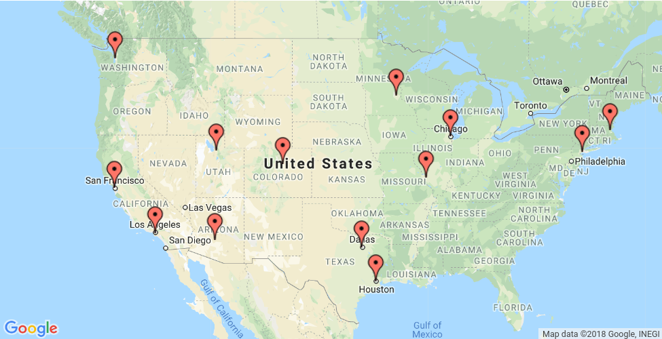

(Traveling Salesman Problem)TSM using GA
TSP is a tradition problem discussed before.
The aim is to travel $n$ cities starting from city $a$ and return to it, without visiting any other cities more than one time, with minimum cost (e.g. distance)
A
G
B
H
K
F
J
M
D
E
C
I
L

Slide 113
Population initialization
Create random initial states (population). Their number equal to population size
A
G
A,D,B,E,C,H,I,L,J,G,A
B
F
J
D
E
C
I
H
----------------------------------------------------------------------------------------
A
G
B
H
A,C,H,B,G,J,L,I,E,D,A
J
D
E
C
I
F

Slide 114
Initial evaluation
We have to select which chromosomes to keep, based on the fitness function
The fitness function for TSP might be the distance of the travel from A and back to it
Use Euclidean distance, for example.

Slide 115
Crossover
A,D,B,E,C,H,I,F,J,G,A
A,C,H,B,G,J,F,I,E,D,A
A,D,B,E,C,J,F,I,E,D,A
Child 1
A,C,H,B,G,H,I,F,J,G,A
Child 2

Slide 116
Cont.
After this crossover, the children have repeated cities, which is illegal
We need to fix this issue
A,D,B,E,C,H,I,F,J,G,A
Parent
A,D,B,E,C,J,F,I,E,D,A
Illegal child
-------------------
A,D,B,E,C,J,F,I,H,D,A
Legal child

Slide 117
Mutation
The mutation is simple here, just pick two random cities and swap them
A,D,B,E,C,J,F,I,H,D,A
R1
R2
A,D,F,E,C,J,B,I,H,D,A

Slide 118
New generation
We create the new generation by performing the previous operations between random states in the population.
The created new generation then becomes our new population, and we repeat the process until a condition is met:
no better solutions are found
or the distance dropped below a specific threshold

